Slide 1
Glenn Ross-Dolan
M.Sc. Bioinformatics and Computational Biology
“Identifying epithelial cell subsets and pathways altered in the intestine of subjects with obesity and diabetes”
Supervised By:
Silvia Melgar & Bastian-Alexander Truppel

Slide 2
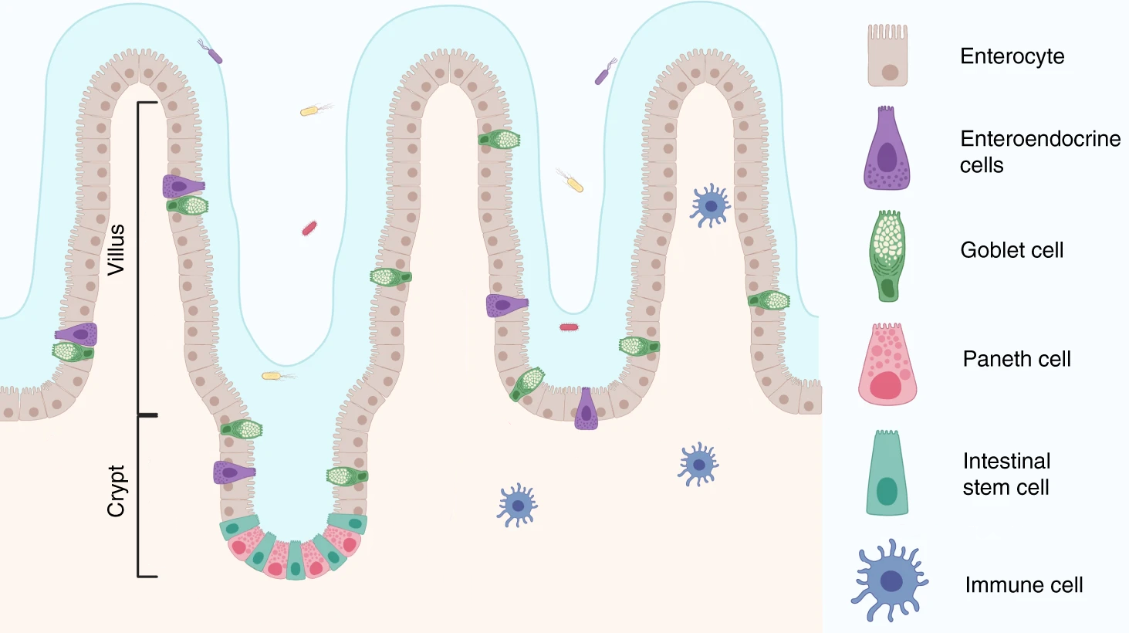
Project Aim
Why?
Complement of Bastian’s Study
Allows him to select biological targets for further study in the seaweed experiments.
Find altered genes/pathways in the individual intestinal cell types which are characteristic of the T2DM subject.
Intestinal Epithelium
Image adapted from: https://www.nature.com/articles/s41467-020-20052-z/figures/1

Slide 3
How?
Choose suitable data ✅
Review literature for best analysis practices ✅
Build an analysis pipeline ✅
Carry out the analysis ⌛
Review the findings 🔜
Form a biological hypothesis 🔜
Build onto the current literature 🔜

Slide 4
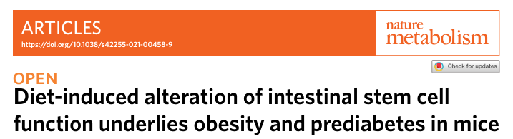


Experimental Model
https://www.nature.com/articles/s42255-021-00458-9
Mice assigned to one of two diets for 12 weeks, until 24 weeks old.
Prediabetic status evaluated.
Intestinal tissue taken and sequenced at the single cell resolution.
Control Diet
High Fat/High Sugar Diet
Week 0
Week 12
Week 24

Slide 5
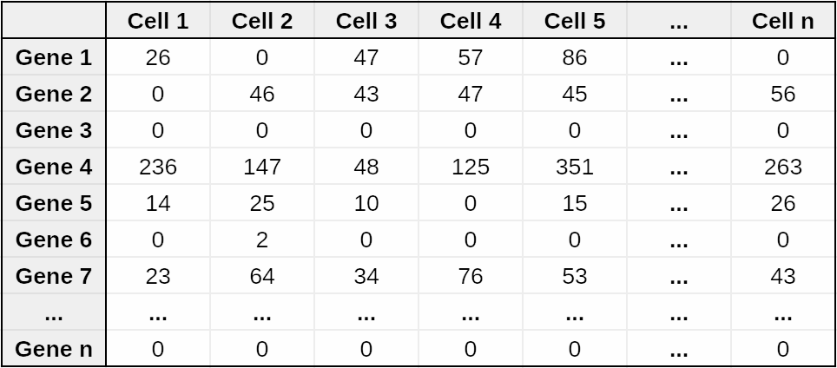
The dataset

Slide 6




Tools
Python
Quality Control
scanpy
Upstream Analysis
R studio
Downstream Analysis
Various R Studio Packages
Limma, Clusterprofiler, enrichplot, gage, DOSE
Downstream Analysis

Slide 7
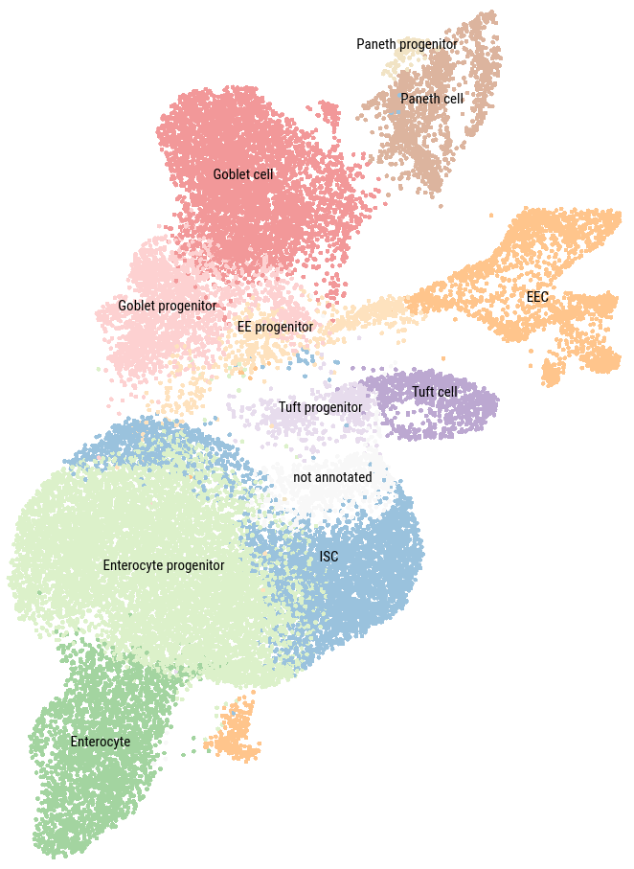
The Pipeline
A series of automated, sequential steps for processing and analysing biological data, ensuring efficient and reproducible workflows.
Raw Data
(Count Table)
Data Cleaning
Quality Control
Doublet Removal
kNN/UMAP
PCA
Feature Selection
Normalisation
Annotated data table ✅
Clustering
Cell Annotation

Slide 8
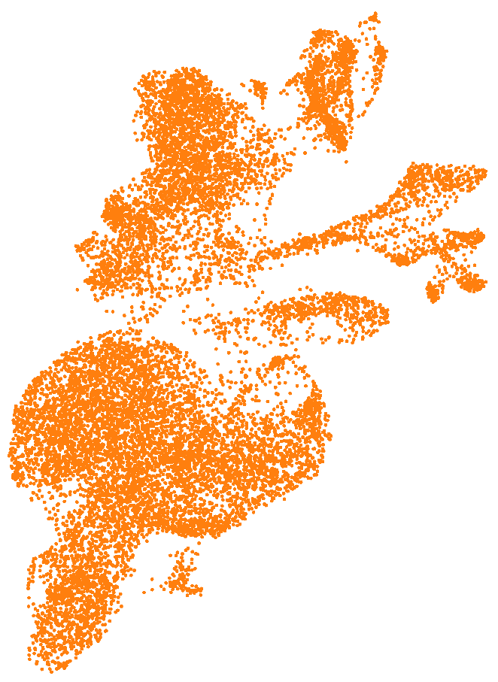
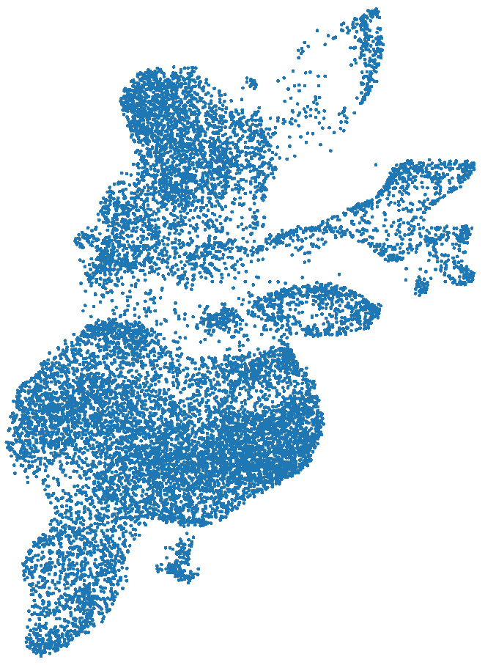
Annotated Dataset
(Intestinal Crypts)
12 clusters
27,687 cells
HFHS Diet Cells
14,321 cells
Control Diet Cells
13,366 cells

Slide 9
The Downstream Pipeline
Gene Ontology Analysis
GO Enrichment Map
Annotated Data Table
DEG Analysis
KEGG Enrichment Analysis
Manual KEGG Pathway Analysis

Slide 10

DEG Analysis (Control VS HFHS)
Limma:
Purpose: Analyse gene expression data for differential expression.
Method: Uses linear models and empirical Bayes methods.
…
A DEG table is produced for each cell type
Each is used in the subsequent downstream analyses

Slide 11
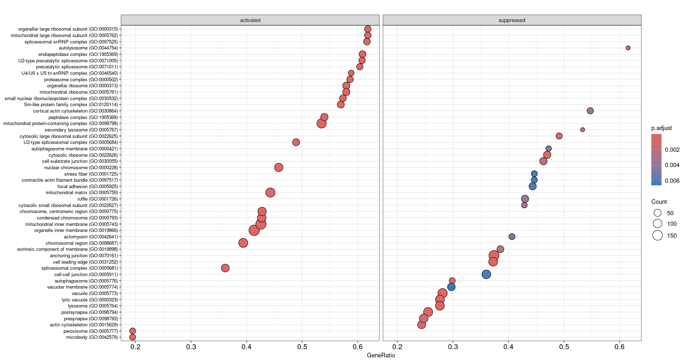
Gene Ontology Term Analysis
GO: Cellular Component

Slide 12
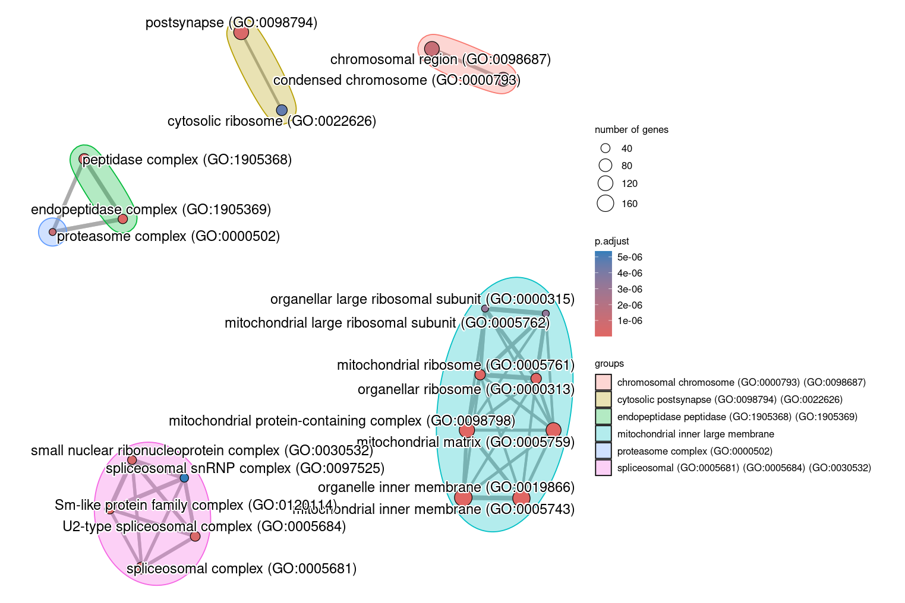
Gene Ontology Enrichment Map
GO: Cellular Component

Slide 13
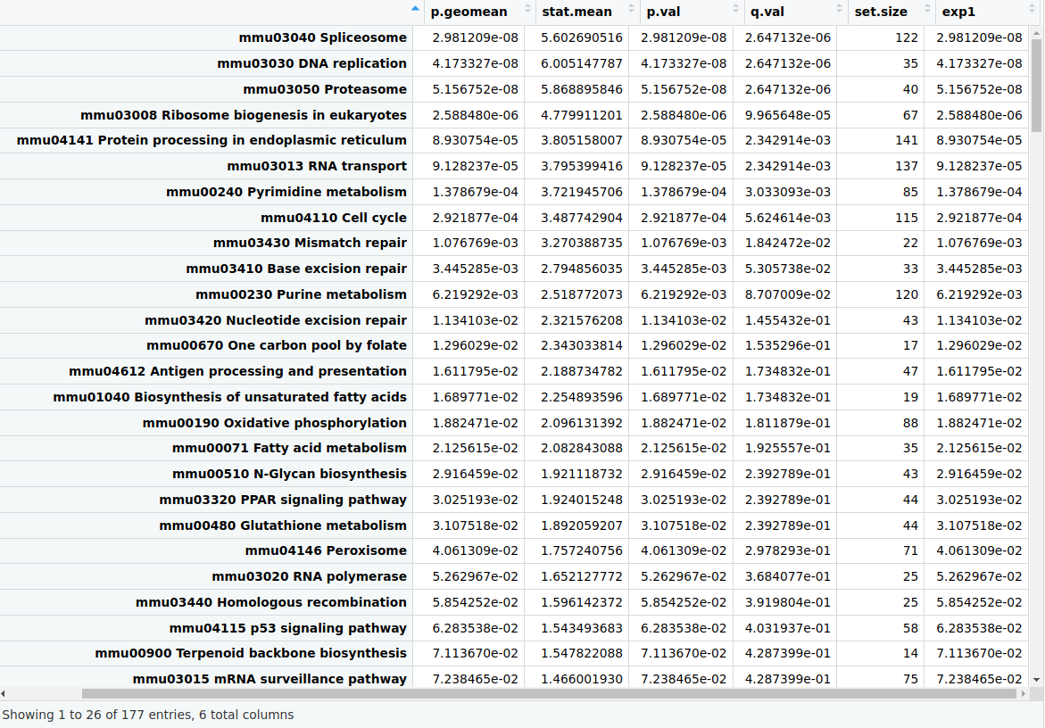
KEGG Pathway Analysis
Increased Pathways

Slide 14
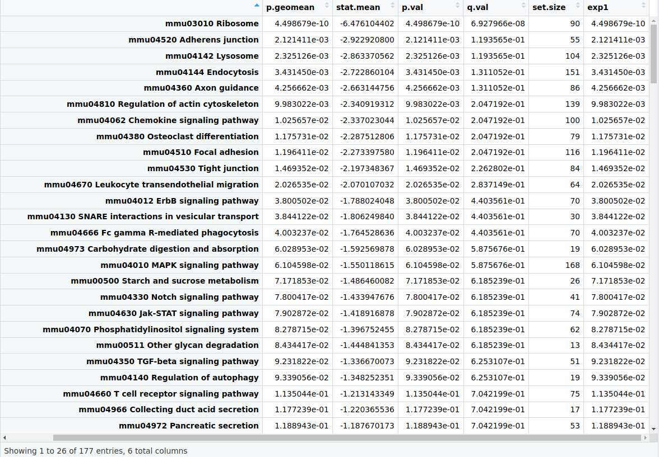
KEGG Pathway Analysis
Decreased Pathways

Slide 15
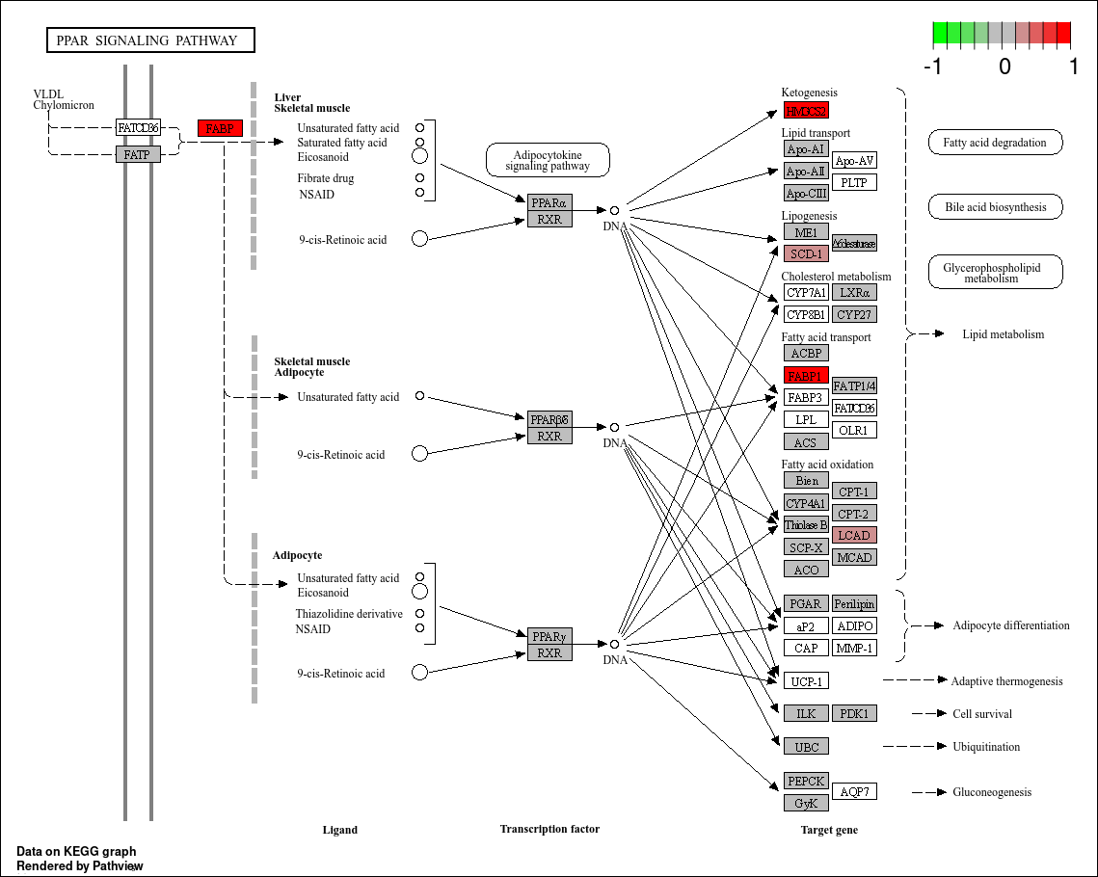
PPAR Pathway (Increased)

Slide 16
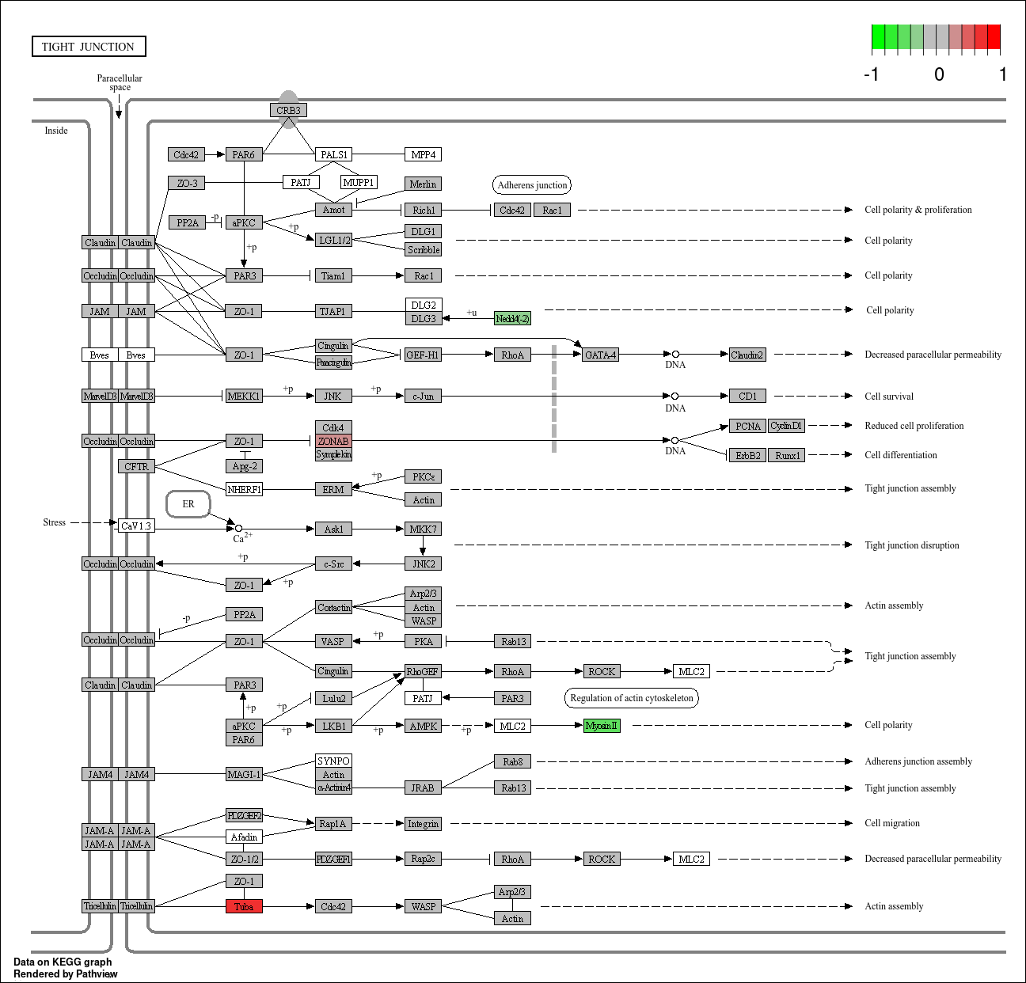
Tight Junction Pathway (Decreased)

Slide 17
Current Problems
Time constraints
All of the data analysis comes from the DEG analysis
Piecing together the data into a meaningful and biologically relevant ideas.
Notes:
Time constraints:
Learning the computational biology behind the scenes
Learning this type of analysis from scratch (not covered in the masters)
Experimenting with packages (I’ve spent time on some packages and ended up not using them - too convoluted, not what was needed)
All Data Comes From The DEG Analysis:
Would like to implement pseudobulk
What is that?
scRNA-seq is looking at the transcriptome at the single cell resolution
Why?
Bulk seq may be a great option for preliminary studies
It is much more cost effective
Requires less starting material

Slide 18
Future Plans / Timeline
Complete Cell Annotation
Present - 21 July 2024
Form Biological Hypothesis
Review the data
29 July 2024 - 16 August 2024
✅
Run Data Through Pipeline
ISC, Paneth Cell, Enterocytes
22 July 2024 - 28 July 2024
Produce First Draft
16 August 2024 - 16 September 2024
✅

Slide 19

Thank You

